Slide 1
Unit 3
Information Technology Components
Lecture 1

Slide 2
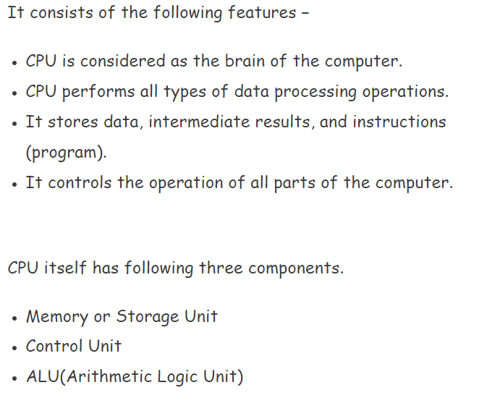
CPU

Slide 3
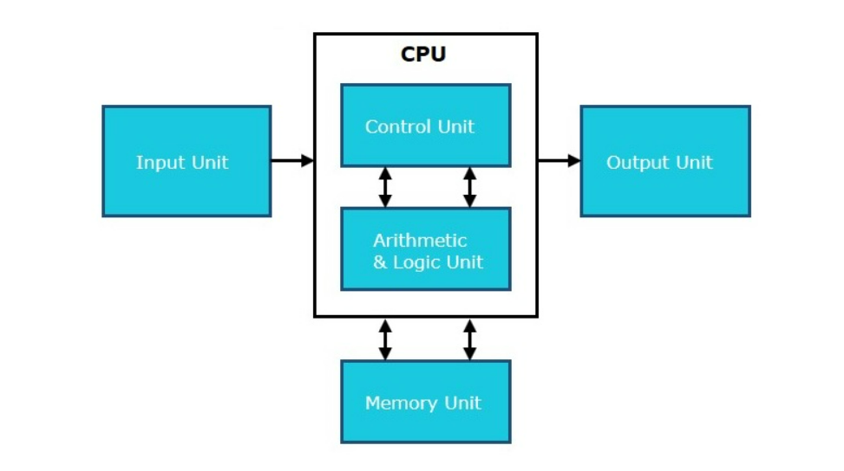

Slide 4
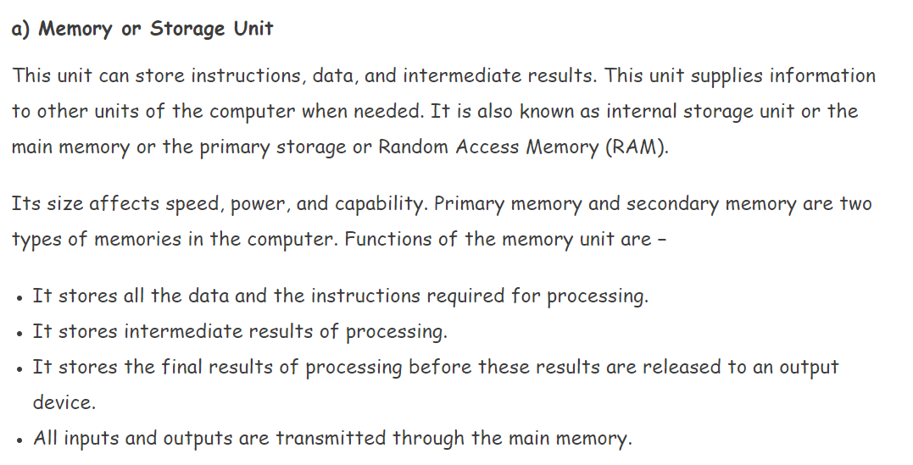

Slide 5
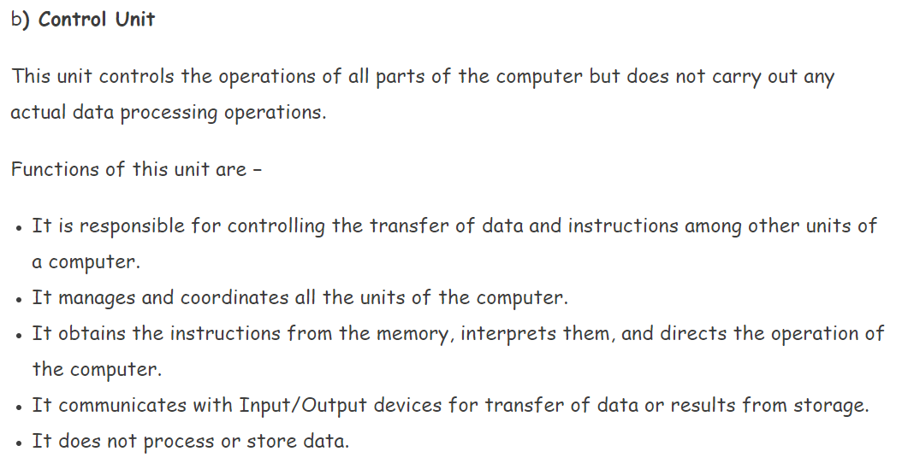

Slide 6
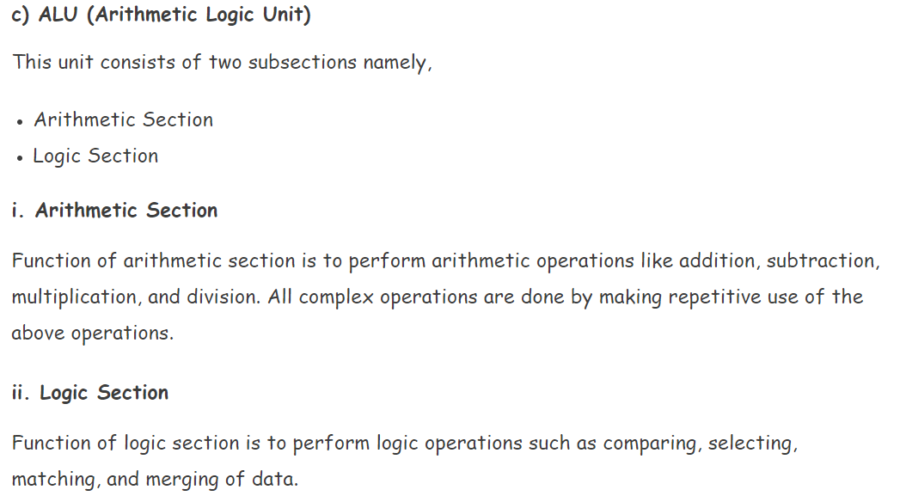

Slide 7
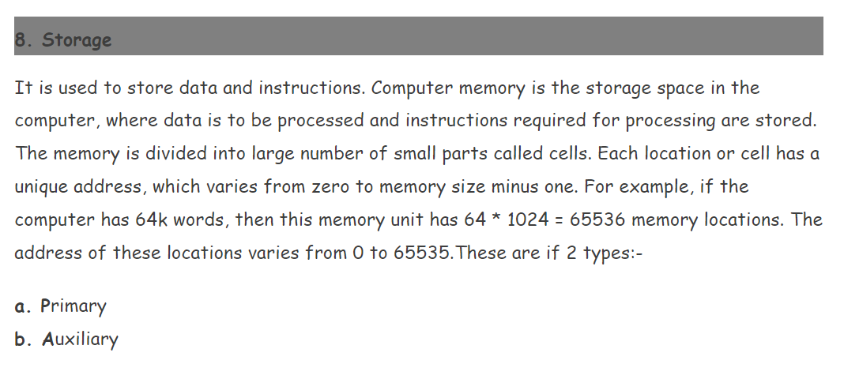

Slide 8
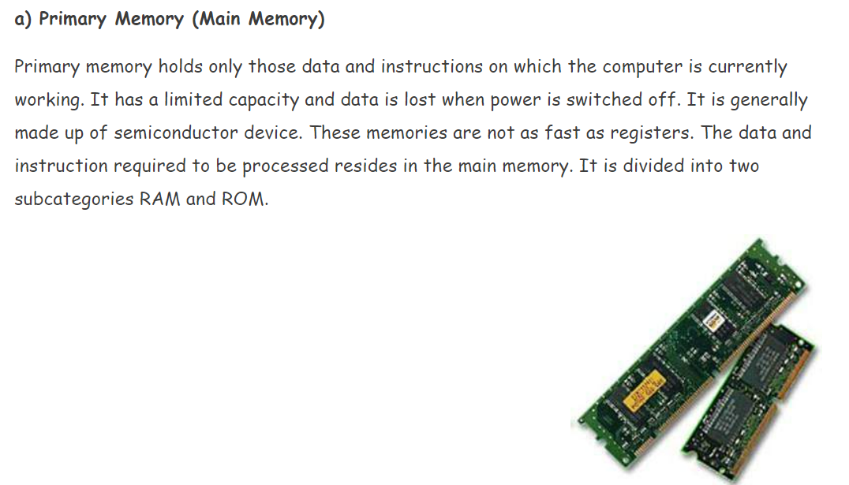

Slide 9
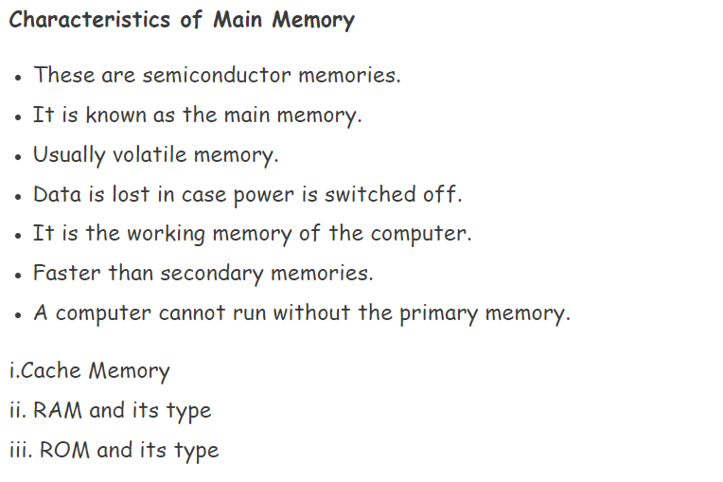

Slide 10
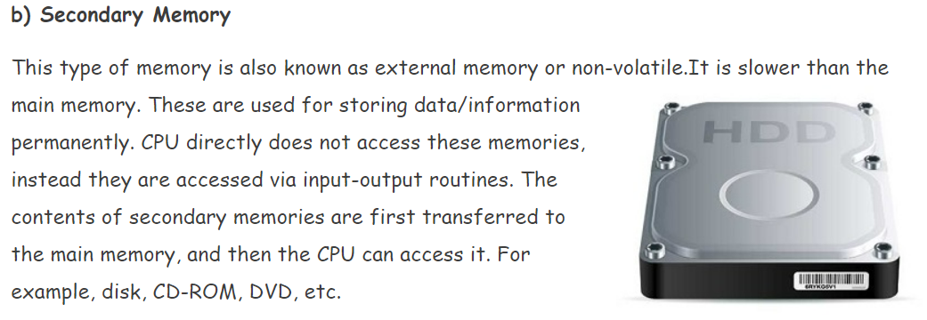

Slide 11
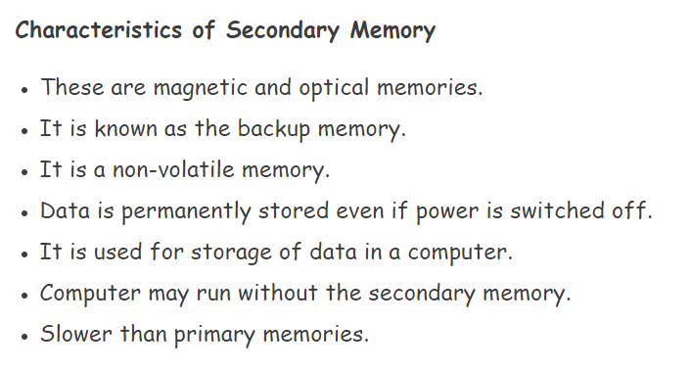

Slide 12
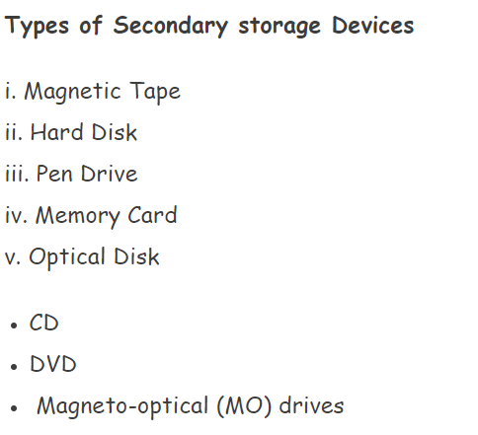

Slide 13
Registers:
Are the smallest and fastest temporary storage locations in the CPU made from electronic devices such as transistors, flip flop etc.
Registers are primarily used to store data temporarily during the execution of program are accessible through instructions.
Registers are directly accessed and manipulated by the CPU.
Registers store data, instructions, addresses and intermediate results of processing.

Slide 14
Some of the important registers in CPU are,
Accumulator (ACC)
IR (Instruction Register)
Memory Address Register (MAR)
Program Counter (PC)
Data Register (DR)
Memory Buffer Register (MBR)

